Slide 1


Customer Subscription Through App Behaviour
By: Ankit Kumar Gupta, Divyanshi Srivastava,
Pranshu Gupta, Aakanksha Jaiswal

Slide 2
Introduction-
With almost every other person carrying an Android device, companies are compelled to provide their services via an android app to their customers. With everything being digitalized, there is an app available for almost every work. Every company is going online to increase their sales and providing its services on one click via an app, that has helped boost their business. An app subscription is a set of benefits that users can access during a stated time period by purchasing the plan.
The subscription model can be applied for various businesses, including:
magazines and newspapers
Software as a Service (SaaS) businesses
gift packages
membership (club, gym, etc.)
and any business that provides recurring products or services
Objective-
The main goal of the company is to sell the premium version app with low advertisement cost for that we have to predict the customer who will take a premium version app subscription or not and then the company will take action on the customers to give the offers or not. The data contain the customer’s behavior and our job is to find the insights from it.

Slide 3
Why App Subscription is important ?
Many companies have a mobile presence to provide free/trial service in an attempt to transfer their customers to a paid membership, such as Netflix, YouTube Red, Microsoft 365, Adobe cloud service and so on.
Companies need to know which customer will most likely to pay for service and to target with offers and promotions;.
Subscribers drive up the value of your company
Subscriptions increase the lifetime value of your customers
Subscriptions smooth out demand
Subscriptions cut the cost of customer market research
Subscriptions automate the collection of receivables
Subscription Create Consistent Income
Subscriptions trigger customers to buy a broader selection of your products and services

Slide 4


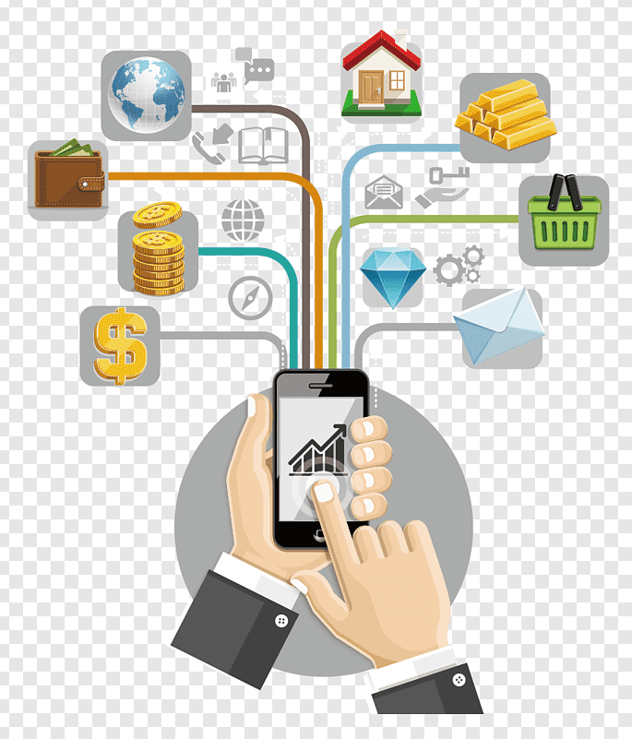
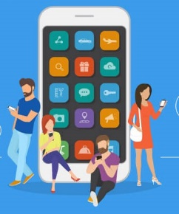
How does the process work?
These Steps are followed by Company for taking action on the customers to give offers or not.
Customer uses the free version App.
Analysis of App behaviour of the customers.
Uses ML Algorithm to make decision.
Customers take Subscription or not.
The customers who may not subscribe predicted by the model, the company could offer them greater discount offer and it will still bring revenue to the company if they decide to accept the offer and subscribe in the end.
Customer
App
Behaviour
Classification algorithm runs inside the machine and makes decision
subscription
yes
No

Slide 5
About DataSet
In the Dataset, there are 50,000 users data with 12 different features-
user: Unique ID for each user.
first_open: Date (yy-mm-dd) and time (Hour:Minute:Seconds:Milliseconds) of login on app first time.
dayofweek: On which day user logon.
Hour: Time of a day in 24-hour format customer logon. It is correlated with dayofweek column.
age: The age of the registered user.
screen_list: The name of multiple screens seen by customers, which are separated by a comma.
numscreens: The total number of screens seen by customer
minigame: app contains small games related to finance. If the customer played mini-game then otherwise 0.
used_premium_feature: If the customer used the premium feature of the app then 1 otherwise 0.
enrolled: If the user bought a premium feature app then 1 otherwise 0.
enrolled_date: On the date (yy-mm-dd) and time (Hour:Minute:Seconds:Milliseconds) the user bought a premium features app.
liked: The each screen of the app has a like button if the customer likes it then 1 otherwise 0.

Slide 6
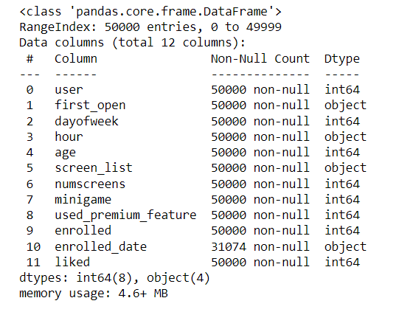
Dataset Analysis
All columns contain 0 null value except enrolled_date. The enrolled_date column has total 18926 null values

Slide 7
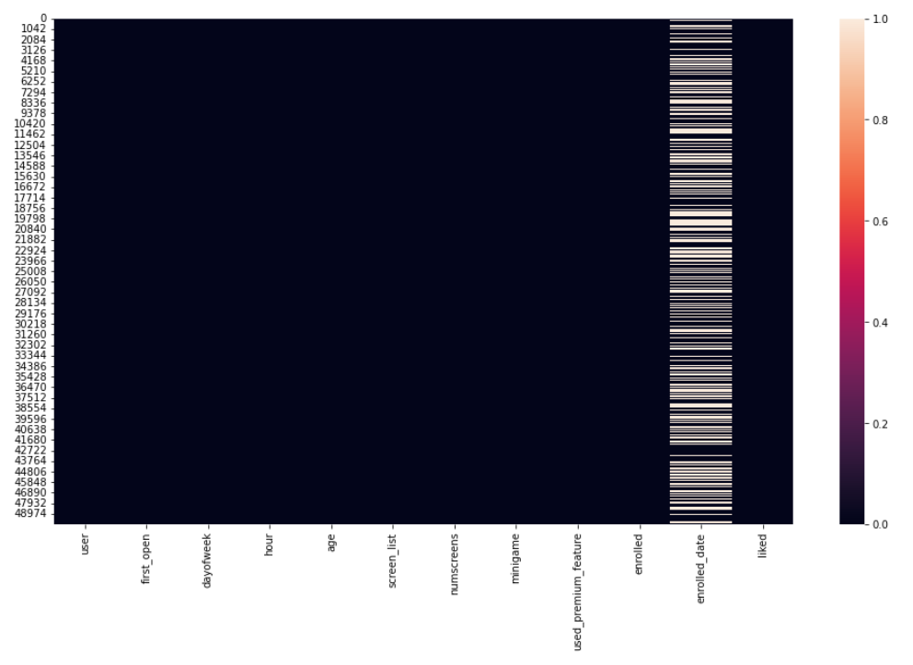
Show the null values using heatmap

Slide 8
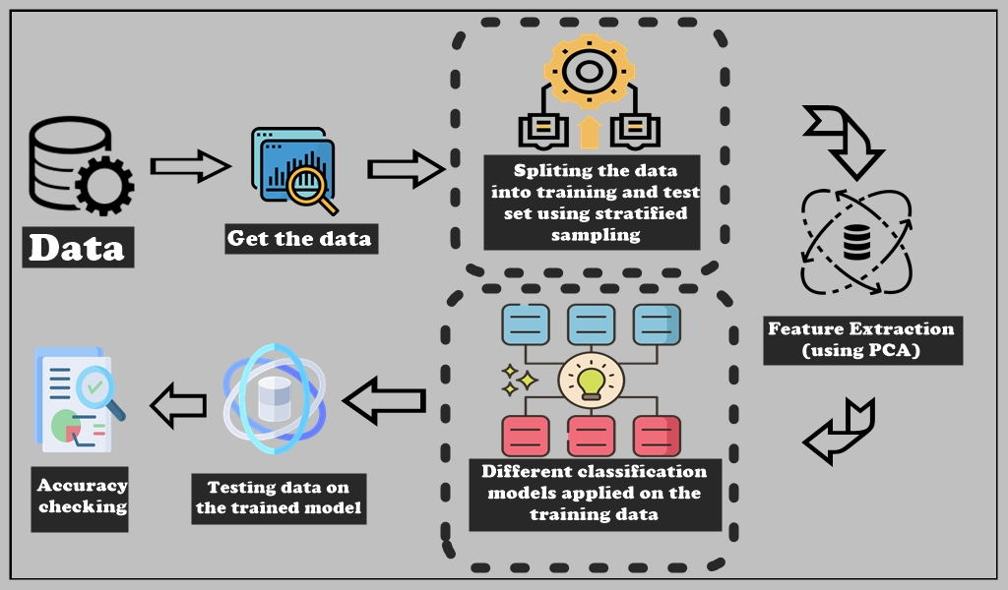
Project View

Slide 9
What we can do?
There are several Machine Learning Algorithm which can be used to detect the fraud transactions. We have used some of them in this project. They are –
Logistic Regression
K – Nearest Neighbours
Naïve Bayes
Support Vector Machine
Decision Tree
Random Forest
XGBoost

Slide 10
Few Terminologies!
.
Logistic Regression: It’s a statistical model which gives a linear boundary to classify the predictor variable very efficiently. As it gives linear boundary, sometimes there is a chance of misclassification.
K-Nearest Neighbors: It’s a nonparametric Supervised Machine learning algorithm used for classification. It calculates the distances of new data point from the k nearest neighbors and count the number of data point in each category. Assign the point to that class which have counted the most neighbors.
Naïve Bayes: It’s a collection of classification algorithms based on Bayes theorem. It used the probability of dependent variable given that all the independent variables have already occurred. Based on the probability, it classifies the dependent variable.
Support Vector Machine: It’s a supervised machine learning algorithm used for Classification and regression both. Here we have used Radial basis function to classify the dependent variable. Radial Basis Kernel is a kernel function that is used in machine learning to find a non-linear classifier or regression line.
Random Forest: It’s one of the mostly used Supervised Machine learning algorithm for classification. Random forest is formed through a bunch of decision tree. Decision tree is collection rules through which classification is made. Using more than one decision trees, make the prediction stable and strong.

Slide 11
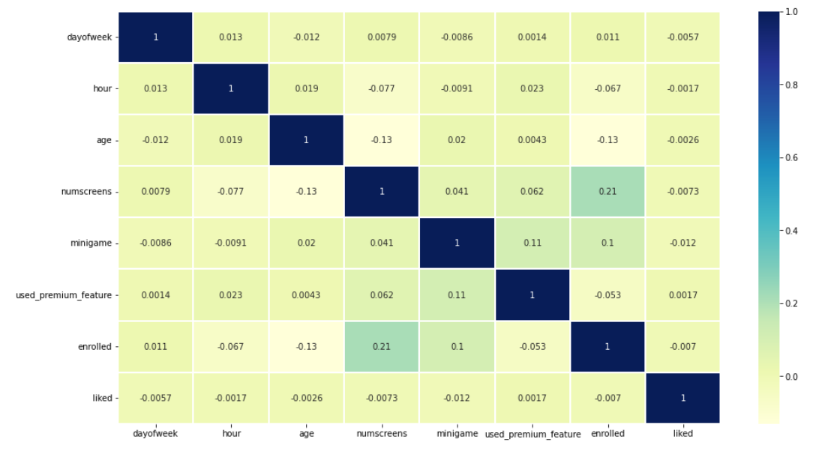
correlation plot

Slide 12
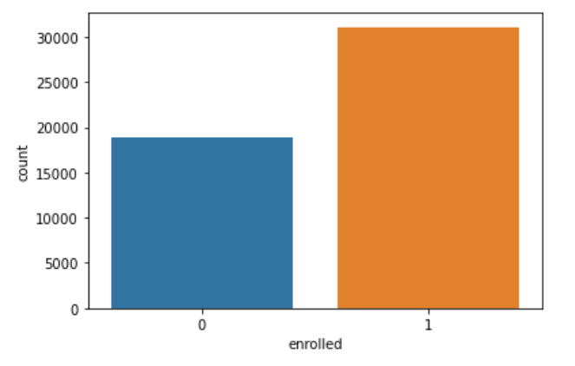

Slide 13
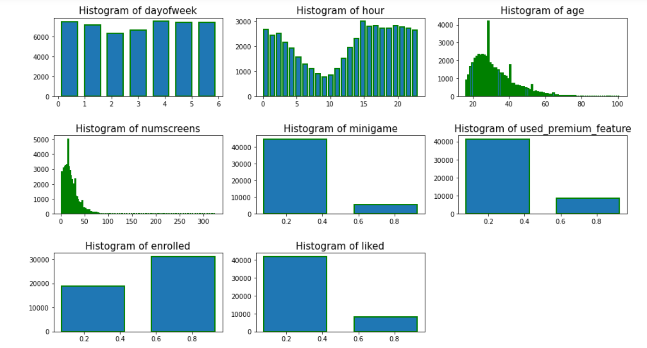

Slide 14
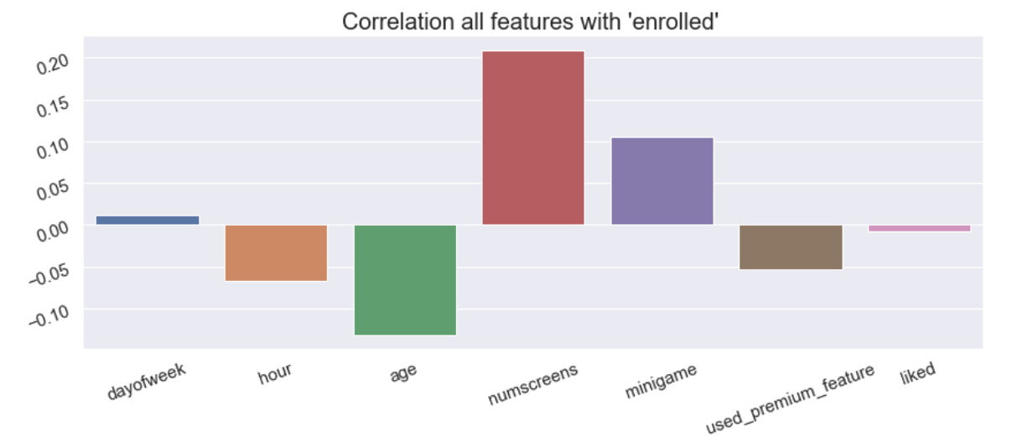
Correlation Barplot

Slide 15
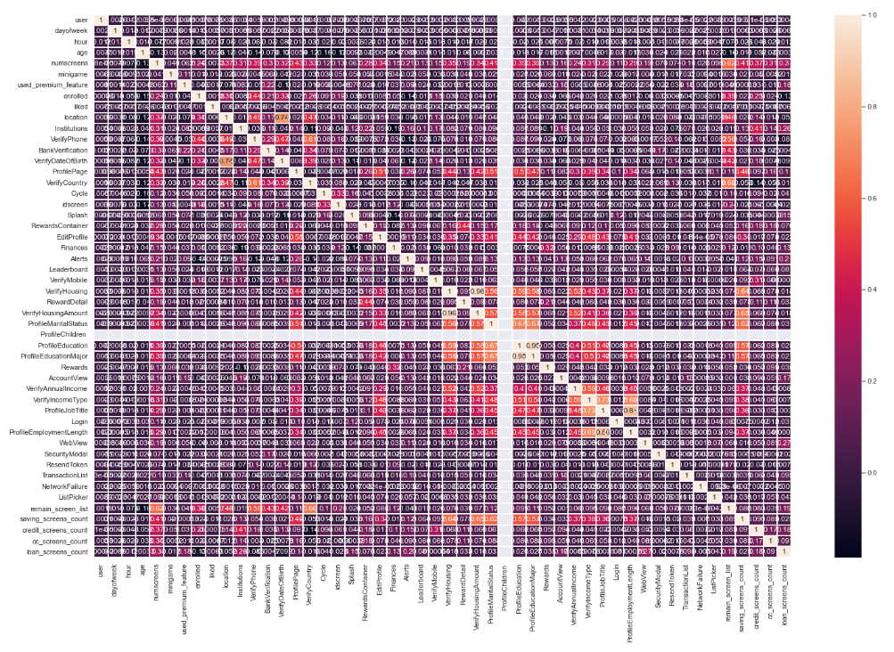
Heatmap with correlation matrix of new AppData

Slide 16
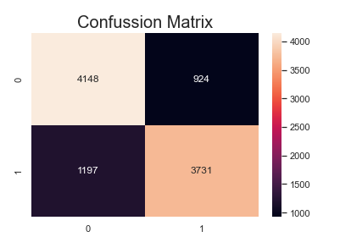

Slide 17
Accuracy Score Comparison
Conclusion:
Name of Classifiers Accuracy Score Accuracy Score
without Feature Scaling with Feature Scaling
Decision Tree 0.6936 0.6932
K-NN 0.6978 0.7315
Naïve Bayes 0.7114 0.7114
Random Forest 0.7621 0.7616
Logistic Regression 0.7681 0.768
Support Vector Machine 0.7609 0.7789
XGBoost 0.781 0.781
XGB with parameter 0.7879 0.7879
tuning
After training different algorithms, we found XGBoost classifiers have given high accuracy of 78.79% in comparison to others. And the company
The model tells us which user will subscribe and who won't. The company can send special offers like 50% of yearly subscription or something else to convert the users whom the model classified as won’t enroll to get them enrolled. This will be profitable for the company. The model can even be implemented daily, and instant offers can be sent as well.

